Slide 1
VIDYA JYOTHI INSTITUTE OF TECHNOLOGY
(Autonomous)
DermaAI – Personalized Skincare
Under the guidance of
Mrs. Qudsia Tahniyath
Assistant Professor
Department of IT
By :Team 47
Deeksha Sandra 22911A12E2
G.R.Akshay Kumar 22911A12E7
K. Sannihitha 22911A12J5
Y.Tejaswini 22911A12K0

Slide 2
Abstract:
This project develops a mobile application that provides personalized skincare recommendations based on individual skin types. It identifies whether a user’s skin is oily, dry, combination, normal, or sensitive through questionnaires or image-based analysis. Using this information, the app suggests suitable skincare products while avoiding ingredients that may cause irritation or allergies. It also offers skincare tips, product reviews, and customized routines to promote effective habits. By combining technology with dermatological knowledge, the application serves as a smart and user-friendly assistant. Ultimately, it helps users make informed decisions, leading to healthier skin and increased confidence.

Slide 3
Introduction
Skincare is important for health, but access to professional dermatological advice is limited for many people
Wide variation in skin types and conditions makes general skincare solutions ineffective
Consumers face confusion due to numerous products and conflicting recommendations
This project introduces a web-based platform using machine learning for personalized skincare guidance
The system uses Flask, SQLite, Random Forest, and NLP to analyze skin type and user concerns for better recommendations

Slide 4
Objectives
Develop a secure authentication system using Flask and SQLite to manage user accounts and store personalized data
Build and train a Random Forest model to accurately classify different skin types from facial images
Perform image preprocessing and feature extraction to improve model accuracy and reliability
Integrate the trained model into the web application for seamless functionality
Enable users to upload images and receive real-time, clear, and personalized skin type predictions

Slide 5
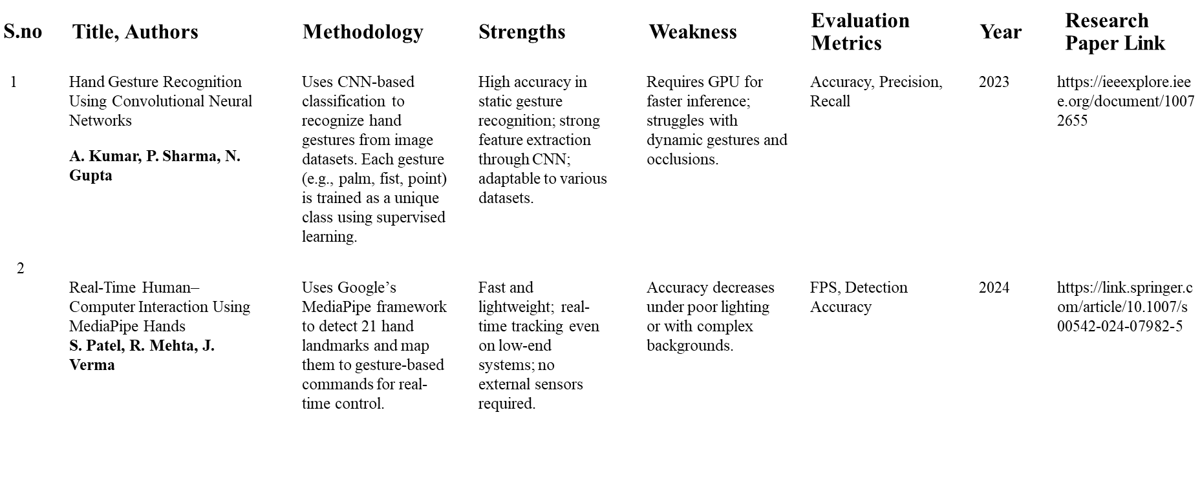
Literature Survey

Slide 6
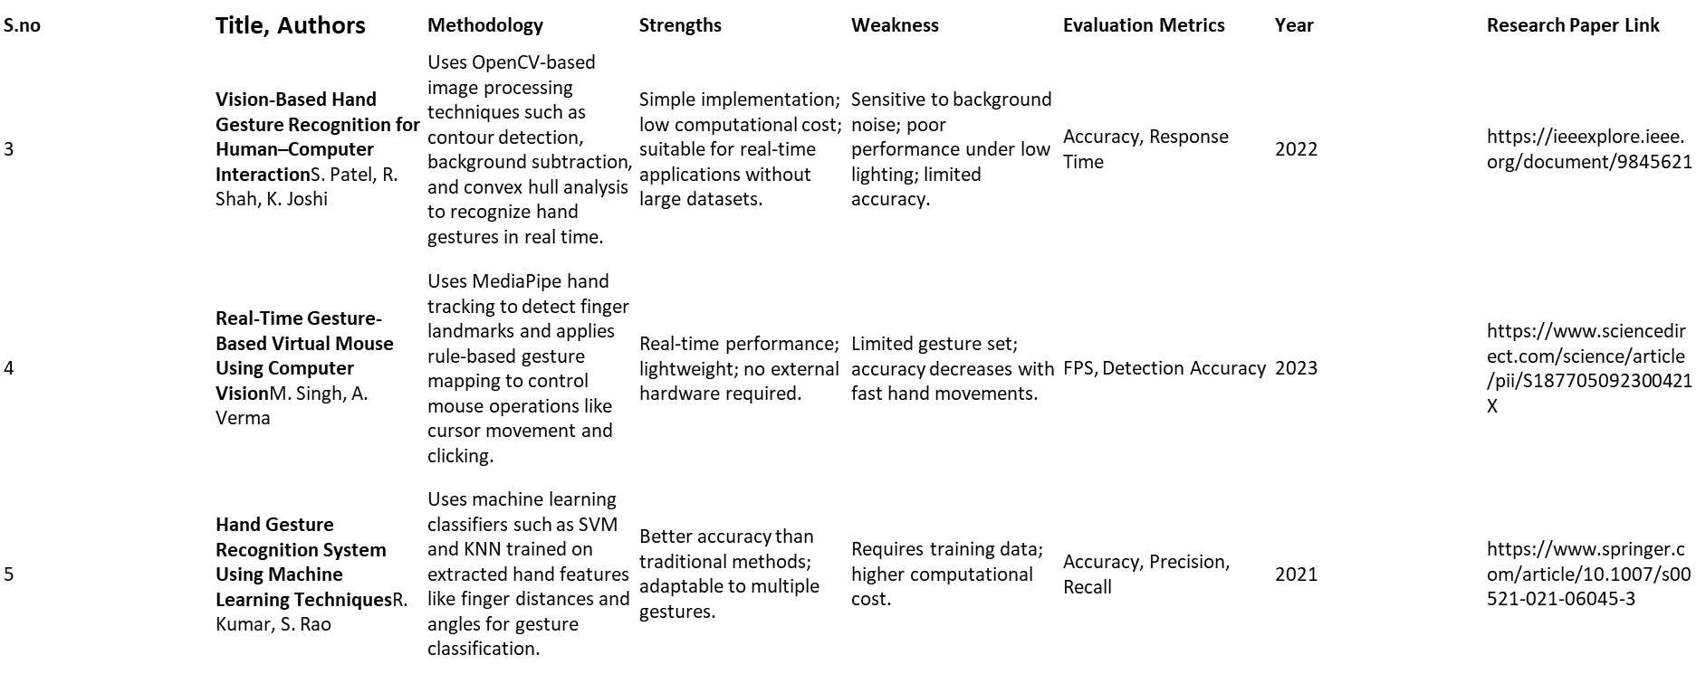
Literature Survey

Slide 7
System requirements
HARDWARE REQUIREMENTS:
System : Pentium IV 2.4 GHz (or equivalent)
Hard Disk : 500 GB
Mouse : Logitech (or similar)
Keyboard : 110 keys enhanced
RAM : 8 GB
SOFTWARE REQUIREMENTS:
O/S : Windows 10,11.
Language : Python
Front End : HTML,CSS
Framework : Flask
Software Used : Anaconda Navigator – Spyder

Slide 8
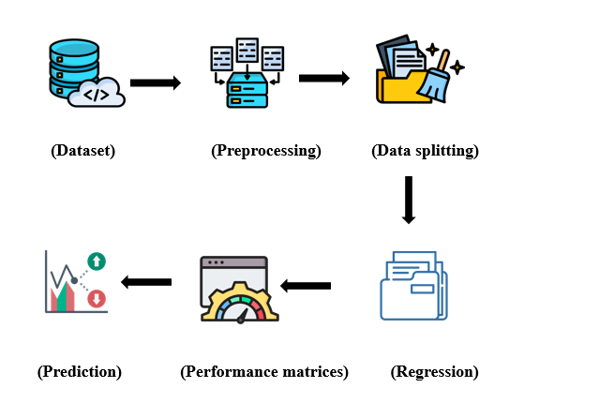
Architecture diagram

Slide 9
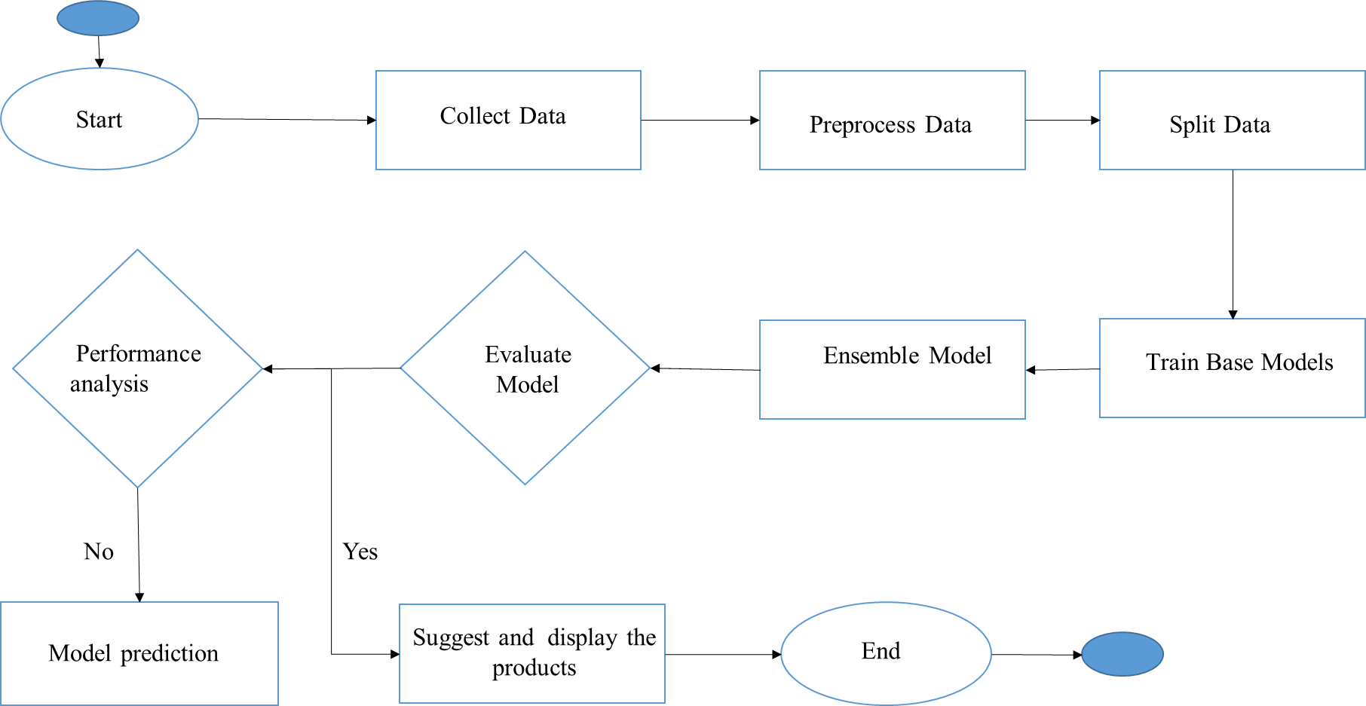
FLOW DIAGRAM

Slide 10
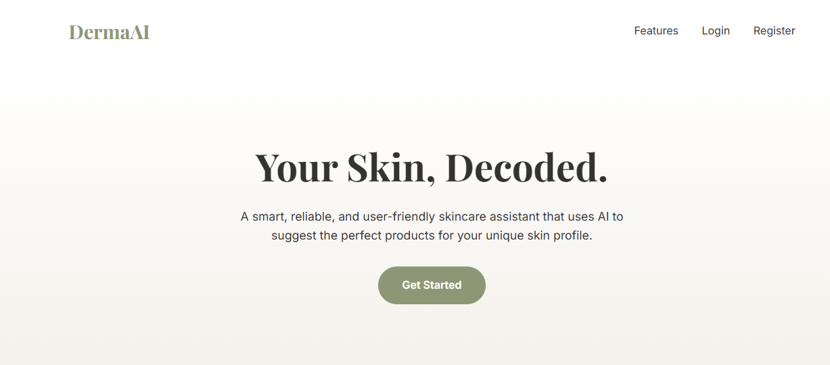
Application Screenshorts

Slide 11
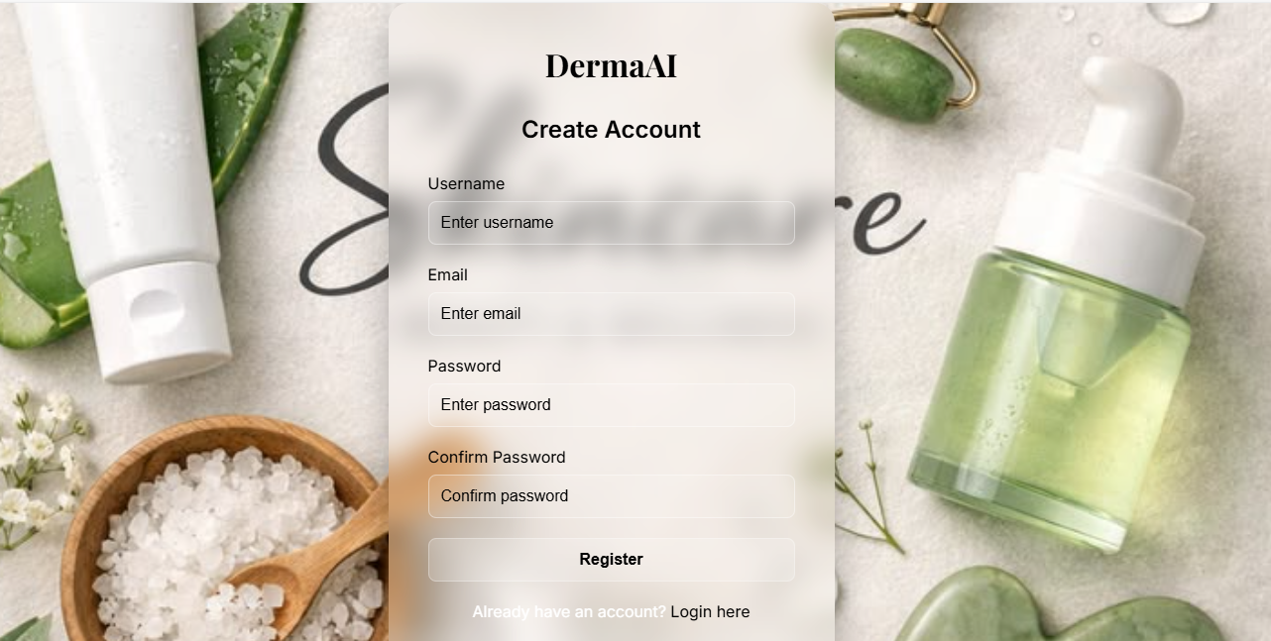
Register Page

Slide 12

Login Page

Slide 13
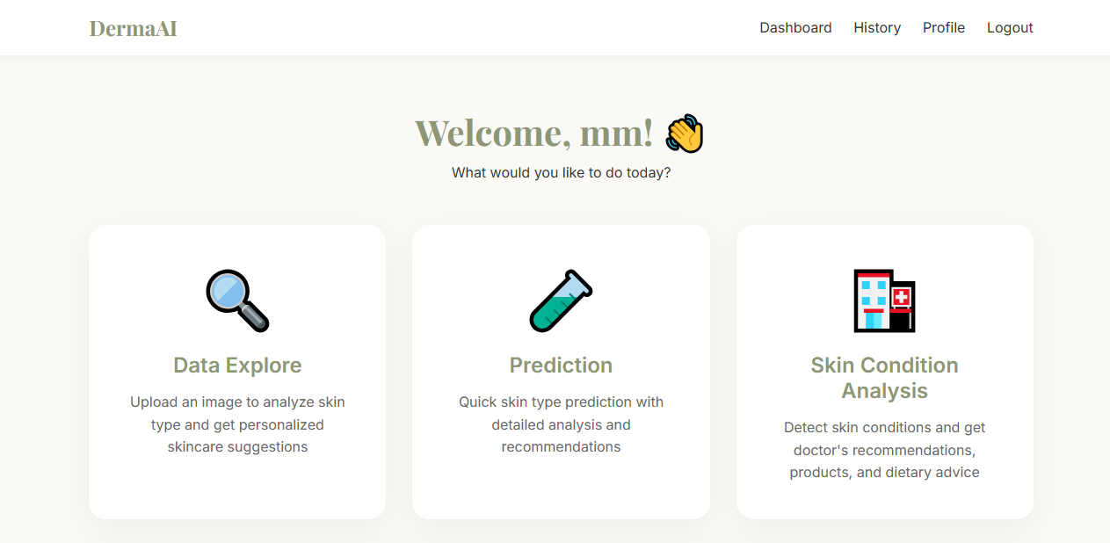
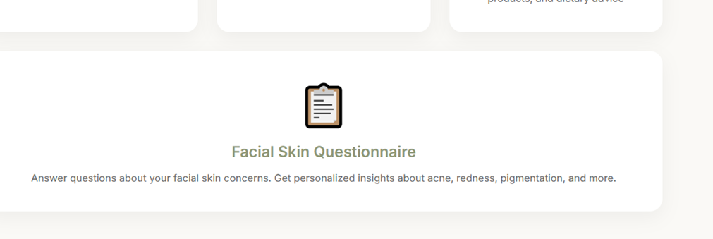
Data explore Page

Slide 14
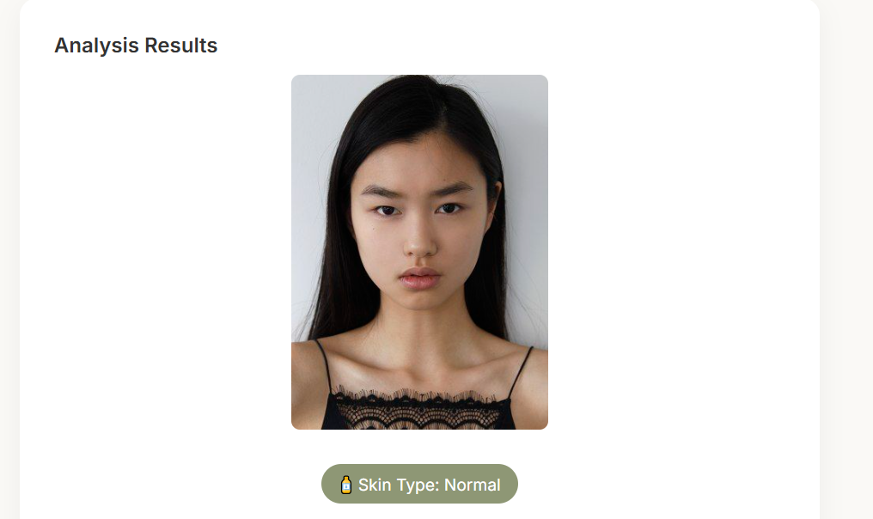
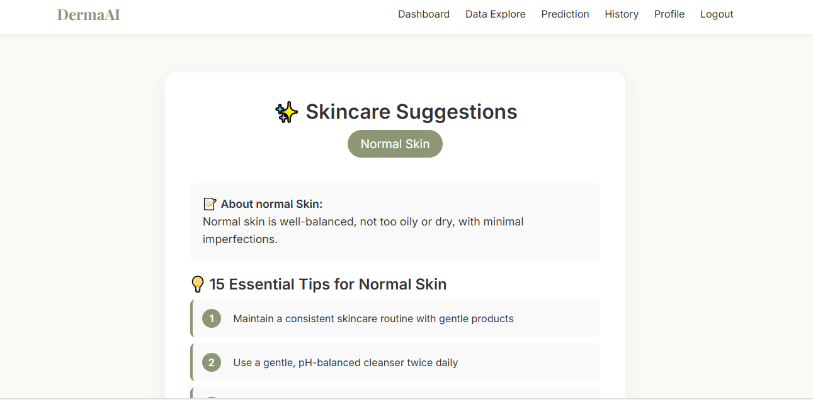
Category

Slide 15
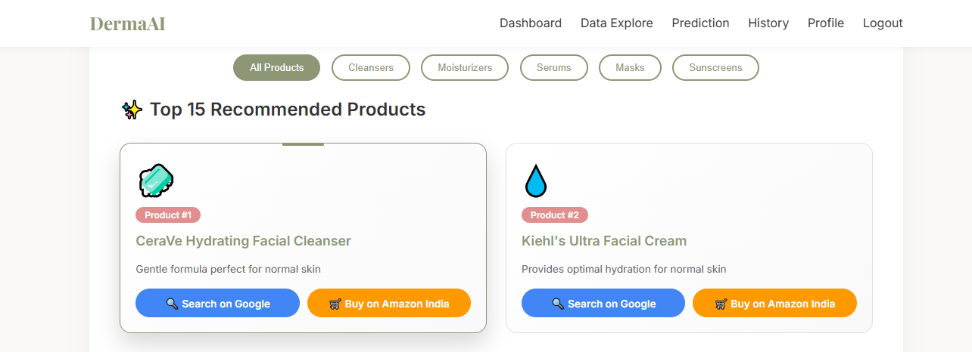
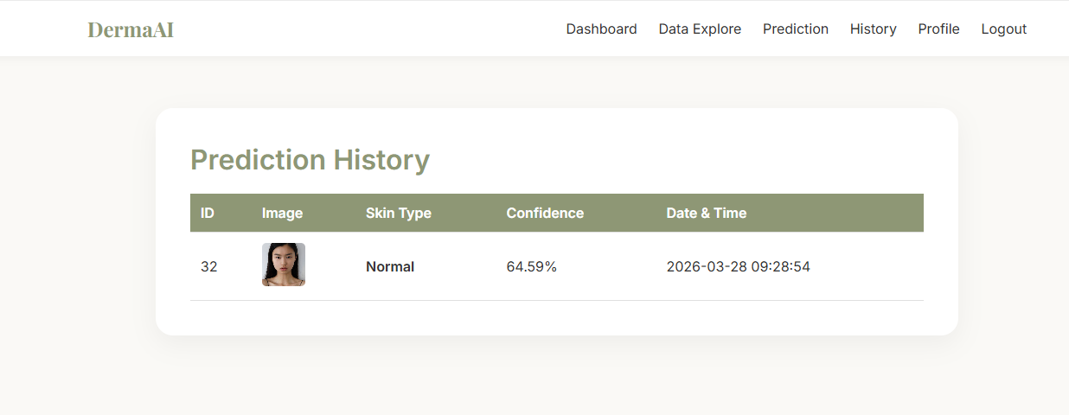
Suppiler

Slide 16
Literature Review
Most existing skincare apps focus only on product promotion or generic advice, without offering deep personalization based on individual skin types and sensitivities. Some AI-based solutions require high-quality medical-grade images or complex inputs, making them less user-friendly for everyday consumers. Few platforms combine AI-driven analysis, skincare education, and personalized routines in one integrated system. There is a need for an accessible, reliable, and user-friendly mobile solution that blends artificial intelligence with dermatological expertise to guide users toward informed skincare decisions.

Slide 17
Existing System
Disadvantages
Limited Skin Type Detection Accuracy: Many existing systems rely only on user-input questionnaires without image-based analysis, leading to inaccurate identification of skin types.
No Ingredient Sensitivity Awareness: Current systems rarely analyze product ingredients or alert users about potential allergens or irritants that may harm sensitive skin.
Poor User Guidance: Users often receive product suggestions without proper skincare routines or tips to build healthy habits.
Limited Accessibility and Convenience: Consulting dermatologists or accessing expert skincare guidance can be time-consuming, expensive, or unavailable in remote areas.

Slide 18
Proposed System
Advantages
Provides personalized skincare recommendations using AI analysis.
Accurately identifies skin type through questionnaire or image input.
Suggests safe products by avoiding harmful or irritating ingredients.
Offers custom skincare tips and routines for healthy skin habits.
Ensures a cost-effective and user-friendly skincare solution anytime, anywhere.

Slide 19
Conclusion
The development of intelligent skincare assistance platform represents a significant advancement in the democratization of personalized skincare expertise. This project successfully delivers a comprehensive, Flask-based web application that integrates machine learning, secure user authentication, and holistic recommendation generation into a unified, accessible system. At the core of the application, a Random Forest classifier is trained to accurately classify four primary skin types—oily, dry, combination, and normal—from user-uploaded facial images, effectively eliminating the subjectivity and inaccuracies inherent in self-assessment methods that plague existing skincare solutions. The Python backend with Flask framework provides a robust, scalable architecture that seamlessly handles user registration, login, session management, image processing, and database operations, while the SQLite database ensures persistent storage of user credentials, skin profiles, analysis history, recommendation logs, and knowledge base content.

Slide 20
Future work
While the current implementation successfully achieves its core objectives, numerous opportunities exist to expand, refine, and enhance the application's capabilities. These future enhancements span multiple dimensions including machine learning advancements, dataset expansion, recommendation system improvements, mobile development, user experience enhancements, scalability upgrades, advanced analytics, external integrations, regulatory compliance, and language localization. The modular architecture of the existing system ensures that these enhancements can be incrementally implemented without disrupting core functionality.

Slide 21
References
[1]Jannatin, A. A., & Ratnasari, C. I. (2025). Personalized Skincare Recommendation System Based on Ontology and User Preferences. bit-Tech, 8(1), 1109-1119.
[2]Crocker Garcia, G., Khan, M. N., Alam, A., Obregon, J., Abuhmed, T., & Huh, E. N. (2025). FiSC: A Novel Approach for Fitzpatrick Scale-Based Skin Analyzer's Image Classification. IEEE Access, 13, 42934-42948.
[3]Malaysian Facial Skin Texture Dataset (MFSTD) Development. (2025). In Proceedings of the International Conference on Image Processing and Computer Vision. IEEE.
[4]Deep Neural Network-Based Personalized Makeup Recommendation Using Korean Skin Physiological Indicators. (2025). Journal of the Korean Society of Cosmetology.
[5]RecomiGlowTech: Cosmetic Recommendation System. (2025). Informatics Institute of Technology, Sri Lanka.

Slide 22
💐 Thank You 💐

